Slide 1
Introduction
FRONT END ENGINEERING -1
PROJECT
EXPENSE TRACKER
Submitted to :
Mrs. Baljit Kaur
Mr. Vikas Patel
Submitted By:
Kshitij Gulati
Kush

Slide 2
Contents
Introduction
Problem Statement
Technical Details
Key Features
Project Highlights
Conclusion
References/Links used

Slide 3
Problem Statement
Create an expense tracking app where users can log and categorize their expenses.

Slide 4




Technical Details
We used HTML, CSS and Bootstrap for UI design and JavaScript for user inputs , data processing and calculations.
We also used Visual Studio Code as editor.
And additionally we utilized Git and GitHub for collaboration.
Github for hosting.

Slide 5
Key Features
Tracking Income and Expenses:
Ability to record income from various sources (salary, investments, etc.)
Easy expense entry .
Categorization of expenses to understand where your money is going (rent, groceries, entertainment, etc.)
Provide visualizations of spending patterns.

Slide 6
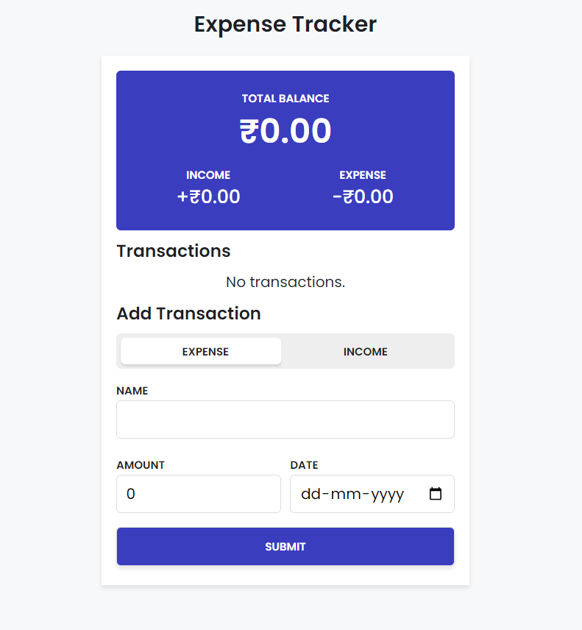
Project Highlights 1

Slide 7
Conclusion
.
We have created a valuable tool for managing personal finances.
This project can empower to take control of financial well-being.

Slide 8
References/Links used
WIKIPEDIA- https://www.wikipedia.org/
W3SCHOOLS-https://www.w3schools.com/
REFERANCE - https://www.splitwise.com/
CSS -https://www.uiverse.io/

Slide 9
Thank You

